Slide 1
How People Do Things

Slide 2
How do people do things?
It is easy to learn a few basic steps to perform operations with our technologies.
But what happens when things go wrong? How do we detect that they aren’t working, and then how do we know what to do?
To help understand this, we need to delve into human psychology and a simple conceptual model of how people select and then evaluate their actions.
This leads the discussion to the role of understanding (via a conceptual model) and of emotions: pleasure when things work smoothly and frustration when our plans are thwarted.

Slide 3
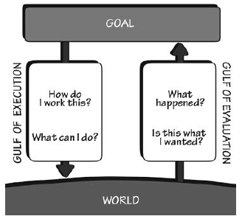
The Gulfs of Execution and Evaluation
USER
When people use something, they face two gulfs:
Gulf of Execution, where they try to figure out how it operates
Gulf of Evaluation, where they try to figure out what happened
The role of the designer is to help people bridge the two gulfs.
/DEVICE

Slide 4
The Gulfs of Execution and Evaluation
The Gulf of Evaluation is typically perceived as easy to bridge, at first.
The Gulf of Evaluation reflects the amount of effort that the person must make to interpret the physical state of the device and to determine how well the expectations and intentions have been met.
The gulf is small when the device provides information about its state in a form that is easy to get, is easy to interpret, and matches the way the person thinks about the system.

Slide 5
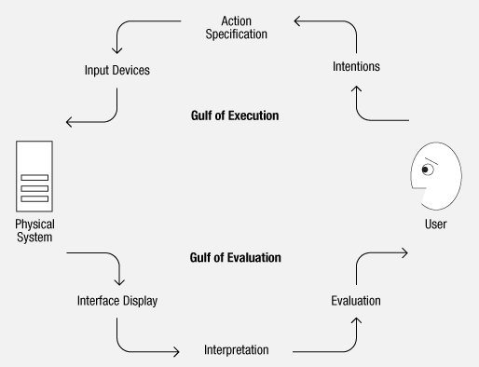
The Gulfs of Execution and Evaluation
What are the major design elements that help bridge the Gulf of Execution?
signifiers, constraints, mappings, and a conceptual model.

Slide 6
The Gulfs of Execution and Evaluation
What are the major design elements that help bridge the Gulf of Evaluation?
Feedback and conceptual model

Slide 7
People frustration
Many people do experience difficulties in using devices and UI, but explain them away by blaming themselves.
In the case of things they believe they should be capable of using they simply think, “I’m being stupid.”
Alternatively, for complicated looking devices they simply give up, deciding that they are incapable of understanding them.
Both explanations are wrong!
The difficulties reside in things design, not in the people attempting to use them.

Slide 8
Our Actions
There are two parts to an action:
executing the action
evaluating the results
doing and interpreting
Both execution and evaluation require understanding: how the item works and what results it produces.
Both execution and evaluation can affect our emotional state.

Slide 9
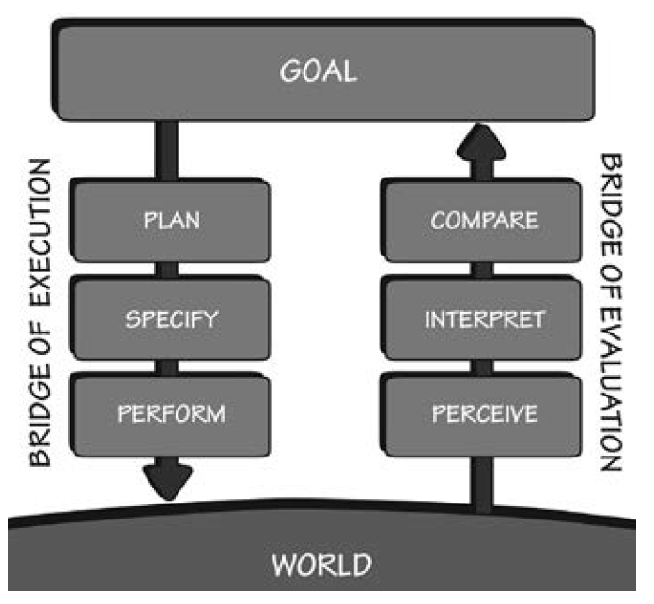
The 7 states of the action
Firstly we (1) specify our goals then we move to the 3 stages of execution:
2 plan 3 specify 4 perform
Evaluating also has 3 stages:
5 perceiving 6 interpreting 7 comparing

Slide 10
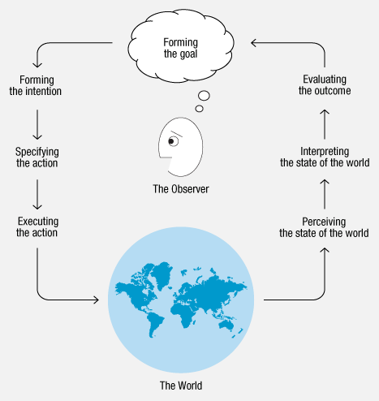
The 7 states of the action
1. Goal (form the goal)
2. Plan (the action)
3. Specify (an action sequence)
4. Perform (the action sequence)
5. Perceive (the state of the world)
6. Interpret (the perception)
7. Compare (the outcome with the goal)

Slide 11
The 7 states of the action
Most behavior does not require going through all stages in sequence
most activities will not be satisfied by single actions. There must be numerous sequences, and the whole activity may last hours or even days.
There are multiple feedback loops in which the results of one activity are used to direct further ones, in which goals lead to subgoals, and plans lead to subplans.
There are activities in which goals are forgotten, discarded, or reformulated.

Slide 12
The 7 states of the action
The seven stages provide a guideline for developing new products or services.
The gulfs are obvious places to start, for either gulf, whether of execution or evaluation, is an opportunity for product enhancement.
The trick is to develop observational skills to detect them

Slide 13
Seven Fundamental Design Principles
The seven-stage model of the action cycle can be a valuable design tool, for it provides a basic checklist of questions to ask.
In general, each stage of action requires its own special design strategies and, in turn, provides its own opportunity for disaster
We can derive 7 questions that anyone using a product should always be able to answer

Slide 14
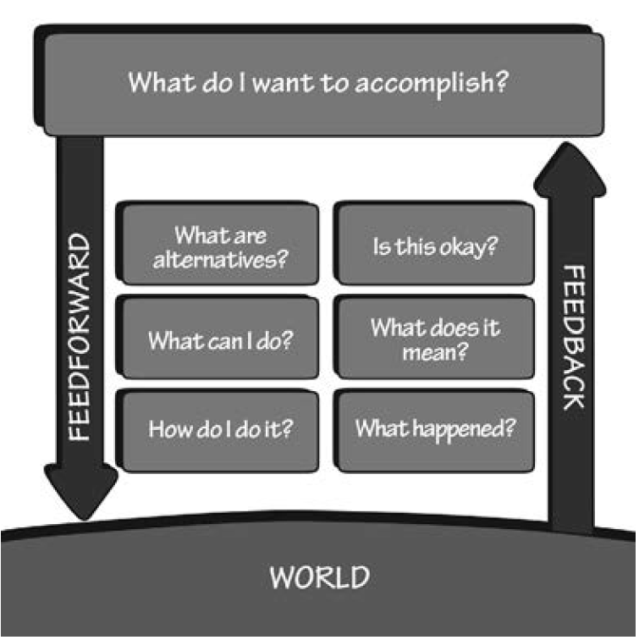
Seven Fundamental Design Principles
1. What do I want to accomplish?
2. What are the alternative action sequences?
3. What action can I do now?
4. How do I do it?
5. What happened?
6. What does it mean?
7. Is this okay? Have I accomplished my goal?

Slide 15

Feedforward and Feedback in interaction
The information that helps answer questions of execution (doing) is feedforward.
The information that aids in understanding what has happened is feedback.

Slide 16
Feedforward and Feedback in interaction
Feedforward is accomplished through appropriate use of signifiers, constraints, and mappings. The conceptual model plays an important role.
Feedback is accomplished through explicit information about the impact of the action. Once again, the conceptual model plays an important role.
Both feedback and feedforward need to be presented in a form that is readily interpreted by the people using the system.

Slide 17
The seven fundamental principles of design
The insights from the seven stages of action lead us to seven fundamental principles of design:
Discoverability. It is possible to determine what actions are possible and the current state of the device.
Feedback. There is full and continuous information about the results of actions and the current state of the product or service. After an action has been executed, it is easy to determine the new state.
Conceptual model. The design projects all the information needed to create a good conceptual model of the system, leading to understanding and a feeling of control. The conceptual model enhances both discoverability and evaluation of results.

Slide 18
The seven fundamental principles of design
4. Affordances. The proper affordances exist to make the desired actions possible.
5. Signifiers. Effective use of signifiers ensures discoverability and that the feedback is well communicated and intelligible.
6. Mappings. The relationship between controls and their actions follows the principles of good mapping, enhanced as much as possible through spatial layout and temporal contiguity.
7. Constraints. Providing physical, logical, semantic, and cultural constraints guides actions and eases interpretation.

Slide 19
Opportunistic actions
For many everyday tasks, goals and intentions are not well specified: they are opportunistic rather than planned.
Opportunistic actions are those in which the behavior takes advantage of circumstances.
Rather than engage in extensive planning and analysis, we go about the day’s activities and do things as opportunities arise.
Thus, we may not have planned to try a new café or to ask a question of a friend.

Slide 20
Opportunistic actions
Opportunistic actions are less precise and certain than specified goals and intentions, but they result in less mental effort, less inconvenience, and perhaps more interest.

Slide 21
Human Thought

Slide 22
Human Thought: Mostly Subconscious
The human mind is immensely complex. Despite many advances in our understanding, much still remains mysterious, yet to be learned.
One of the mysteries concerns the nature of and distinction between those activities that are conscious and those that are not.
Most of the brain’s operations are subconscious, hidden beneath our awareness. It is only the highest level, what I call reflective, that is conscious.
Conscious attention is necessary to learn most things, but after the initial learning, continued practice and study, sometimes for thousands of hours over a period of years, produces what psychologists call “overlearning,” Once skills have been overlearned, performance appears to be effortless, done automatically, with little or no awareness.

Slide 23
Human Thought: Mostly Subconscious
In the house you lived in three houses ago, as you entered the front door, was the doorknob on the left or right?
Now you have to engage in conscious, reflective problem solving, first to retrieve just which house is being talked about, and then what the correct answer is.
Most people can determine the house, but have difficulty answering the question because they can readily imagine the doorknob on both sides of the door.
The way to solve this problem is to imagine doing some activity, such as walking up to the front door while carrying heavy packages with both hands: how do you open the door? Alternatively, visualize yourself inside the house, rushing to the front door to open it for a visitor.

Slide 24
Conscious vs Subconscious thought
Subconscious thought matches patterns, finding the best possible match of one’s past experience to the current one. It proceeds rapidly and automatically, without effort.
Subconscious processing is one of our strengths. It is good at detecting general trends, at recognizing the relationship between what we now experience and what has happened in the past.
Conscious thought is quite different. It is slow and labored. Here is where we slowly ponder decisions, think through alternatives, compare different choices. Conscious thought considers first this approach, then that—comparing, rationalizing, finding explanations. Formal logic, mathematics, decision theory: these are the tools of conscious thought.

Slide 25
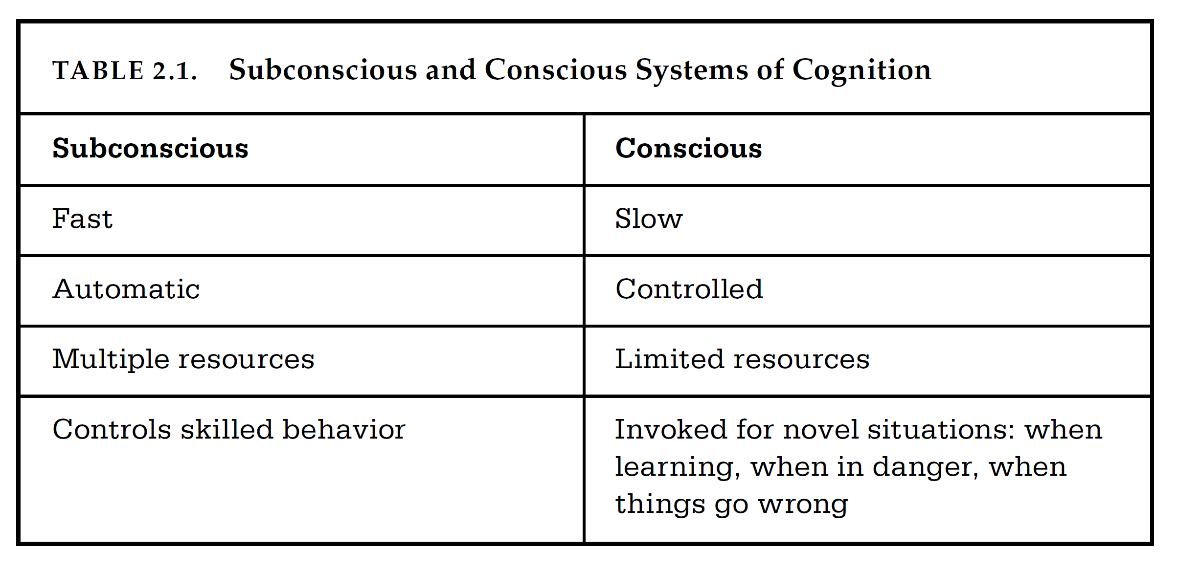

Slide 26
Declarative Vs Procedural memory
All these tasks involve long-term memory, but in very different ways.
Questions like “What is the capital of Brazil?” require retrieving factual information, what is called declarative memory.
The door knob position question could have been answered factually, but is usually most easily answered by recalling the activities performed to open the door. This is called procedural memory.

Slide 27
Emotions and cognition
Emotion interacts with cognition biochemically with hormones modifying the behavior of brain cells. Hormones exert powerful biases on brain operation.
Thus, in tense, threatening situations, the emotional system triggers the release of hormones that bias the brain to focus upon relevant parts of the environment.
In calm, non-threatening situations, the emotional system triggers the release of hormones that relax the muscles and bias the brain toward exploration and creativity.
Now the brain is more apt to notice changes in the environment, to be distracted by events, and to piece together events and knowledge that might have seemed unrelated earlier.
A positive emotional state is ideal for creative thought, but it is not very well suited for getting things done.

Slide 28
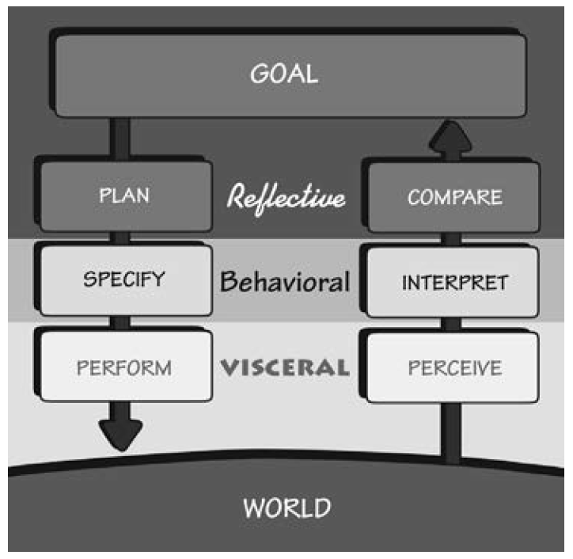
Three Levels of Processing
A gross oversimplification of the brain processing is based on the splitting of the brain in 3 procedural levels: Visceral, behavioral and reflective.
visceral level (the lizard brain) These is part of the basic protective mechanisms of the human affective system, making quick judgments about the environment: good or bad, safe or dangerous.
The visceral system allows us to respond quickly and subconsciously, without conscious awareness or control.
The basic biology of the visceral system minimizes its ability to learn. Visceral learning takes place primarily by sensitization or desensitization. Visceral responses are fast and automatic.

Slide 29
Visceral level
For designers, the visceral response is about immediate perception: the pleasantness of a mellow, harmonious sound or the jarring, irritating scratch of fingernails on a rough surface.
Here is where the style matters: appearances, whether sound or sight, touch or smell, drive the visceral response. This has nothing to do with how usable, effective, or understandable the product is. It is all about attraction or repulsion. Great designers use their aesthetic sensibilities to drive these visceral responses.
Engineers and other logical people tend to dismiss the visceral response as irrelevant. Engineers are proud of the inherent quality of their work and dismayed when inferior products sell better “just because they look better.” But all of us make these kinds of judgments, even those very logical engineers.

Slide 30
Three Levels of Processing
The behavioral level is the home of learned skills, triggered by situations that match the appropriate patterns.
Actions and analyses at this level are largely subconscious. Even though we are usually aware of our actions, we are often unaware of the details.
When we speak, we often do not know what we are about to say until our conscious mind (the reflective part of the mind) hears ourselves uttering the words.

Slide 31
Behavioral level
For designers, the most critical aspect of the behavioral level is that every action is associated with an expectation. Expect a positive outcome and the result is a positive affective response (a “positive valence,” in the scientific literature).
Expect a negative outcome and the result is a negative affective response (a negative valence): dread and hope, anxiety and anticipation.
The information in the feedback loop of evaluation confirms or disconfirms the expectations, resulting in satisfaction or relief, disappointment or frustration.
Behavioral states are learned. They give rise to a feeling of control when there is good understanding and knowledge of results, and frustration and anger when things do not go as planned
Feedback is critical to managing expectations

Slide 32
Three Levels of Processing
The reflective level is the home of conscious cognition. As a consequence, this is where deep understanding develops, where reasoning and conscious decision-making take place.
The visceral and behavioral levels are subconscious and, as a result, they respond rapidly, but without much analysis. Reflection is cognitive, deep, and slow.
It often occurs after the events have happened.
The highest levels of emotions come from the reflective level, for it is here that causes are assigned and where predictions of the future take place. Adding causal elements to experienced events leads to such emotional states as guilt and pride (when we assume ourselves to be the cause) and blame and praise (when others are thought to be the cause).

Slide 33
Reflective level
To the designer, reflection is perhaps the most important of the levels of processing.
Reflection is conscious, and the emotions produced at this level are the most protracted: those that assign agency and cause, such as guilt and blame or praise and pride.
Reflective responses are part of our memory of events. Memories last far longer than the immediate experience or the period of usage, which are the domains of the visceral and behavioral levels.
It is reflection that drives us to recommend a product, to recommend that others use it—or perhaps to avoid it.
Reflective memories are often more important than reality.

